Slide 1


WIN MORE GOVERNMENT CONTRACTS
Turn complex RFPs into winning proposals
with Proposal Connect — the AI-powered GovCon platform.
From discovery to signed submission.
proposalconnect.io · +1 (301) 507-0270
Notes:
Open with the brand promise: Proposal Connect is a next-gen, AI-powered GovCon platform. Discover, capture, win.

Slide 2


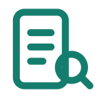



THE PROBLEM
02 / 15
Winning GovCon work is broken.
Four ways a pursuit falls apart — long before a proposal is ever written.
01
02
Missed opportunities
Slow, manual proposals
Relevant solicitations slip through the cracks across SAM.gov, GovWin, and agency portals — lost before the pursuit even starts.
Reading 200-page RFPs and drafting by hand takes weeks teams don’t have.
$750B+
in federal contracts awarded every year
3–6 wks
average time to complete a single proposal
03
04
Compliance risk
Wasted bid spend
A single missed “shall” requirement can disqualify an otherwise winning proposal.
Time and money pour into no-win pursuits without a disciplined GO/NO-GO process.
1 miss
can disqualify an entire submission
~25%
average GovCon proposal win rate
proposalconnect.io
Notes:
Four ways GovCon pursuits break down before a proposal is even written: missed opportunities, slow manual proposals, compliance risk, wasted bid spend.

Slide 3

THE SOLUTION
03 / 15
One platform. The entire pursuit.
AI reads every RFP, drafts compliant sections, and tracks every requirement — capture to submission.
Instant RFP analysis— extracted in minutes
Up to 70% faster proposals— AI-assisted drafting
Watch the 2-minute product demo
Compliance built in— every “shall” tracked
VIDEO COMING SOON
Smarter bid decisions— structured GO/NO-GO
Built-in CRM — agencies, partners & contacts in one place
proposalconnect.io
Notes:
Open with the brand promise: Proposal Connect is a next-gen, AI-powered GovCon platform. Discover, capture, win.

Slide 4

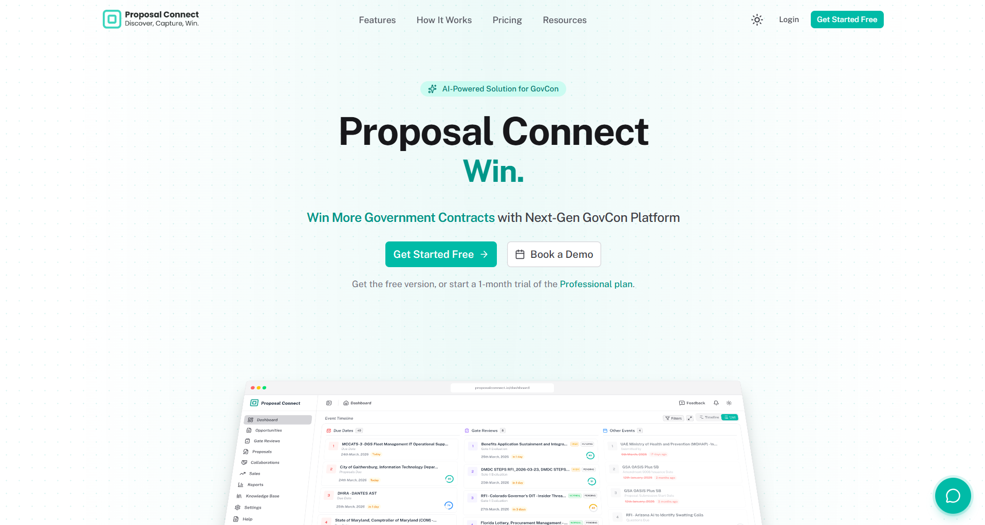




WHO BENEFITS FROM PROPOSAL CONNECT?
04 / 15
Everyone who bids.
WHO WINS THE WORK
Federal Contractors
Win federal work sourced from GovWin IQ and SAM.gov.
proposalconnect.io
State & Local Vendors
Track SLED opportunities and pursuits across jurisdictions.
Small Biz / SDVOSB / 8(a)
Compete with enterprise-grade tooling — no enterprise team required.
WHO DOES THE WORK
Capture & BD Teams
Build pipeline visibility and make disciplined bid calls.
Proposal Managers & Writers
Draft with AI, track compliance, and edit collaboratively.
Teaming Partners & Subs
Find partners and collaborate across organizations.
proposalconnect.io
Notes:
Built for every team in the pursuit: federal contractors, SLED vendors, small business / SDVOSB / 8(a), capture & BD teams, proposal managers, and teaming partners.

Slide 5
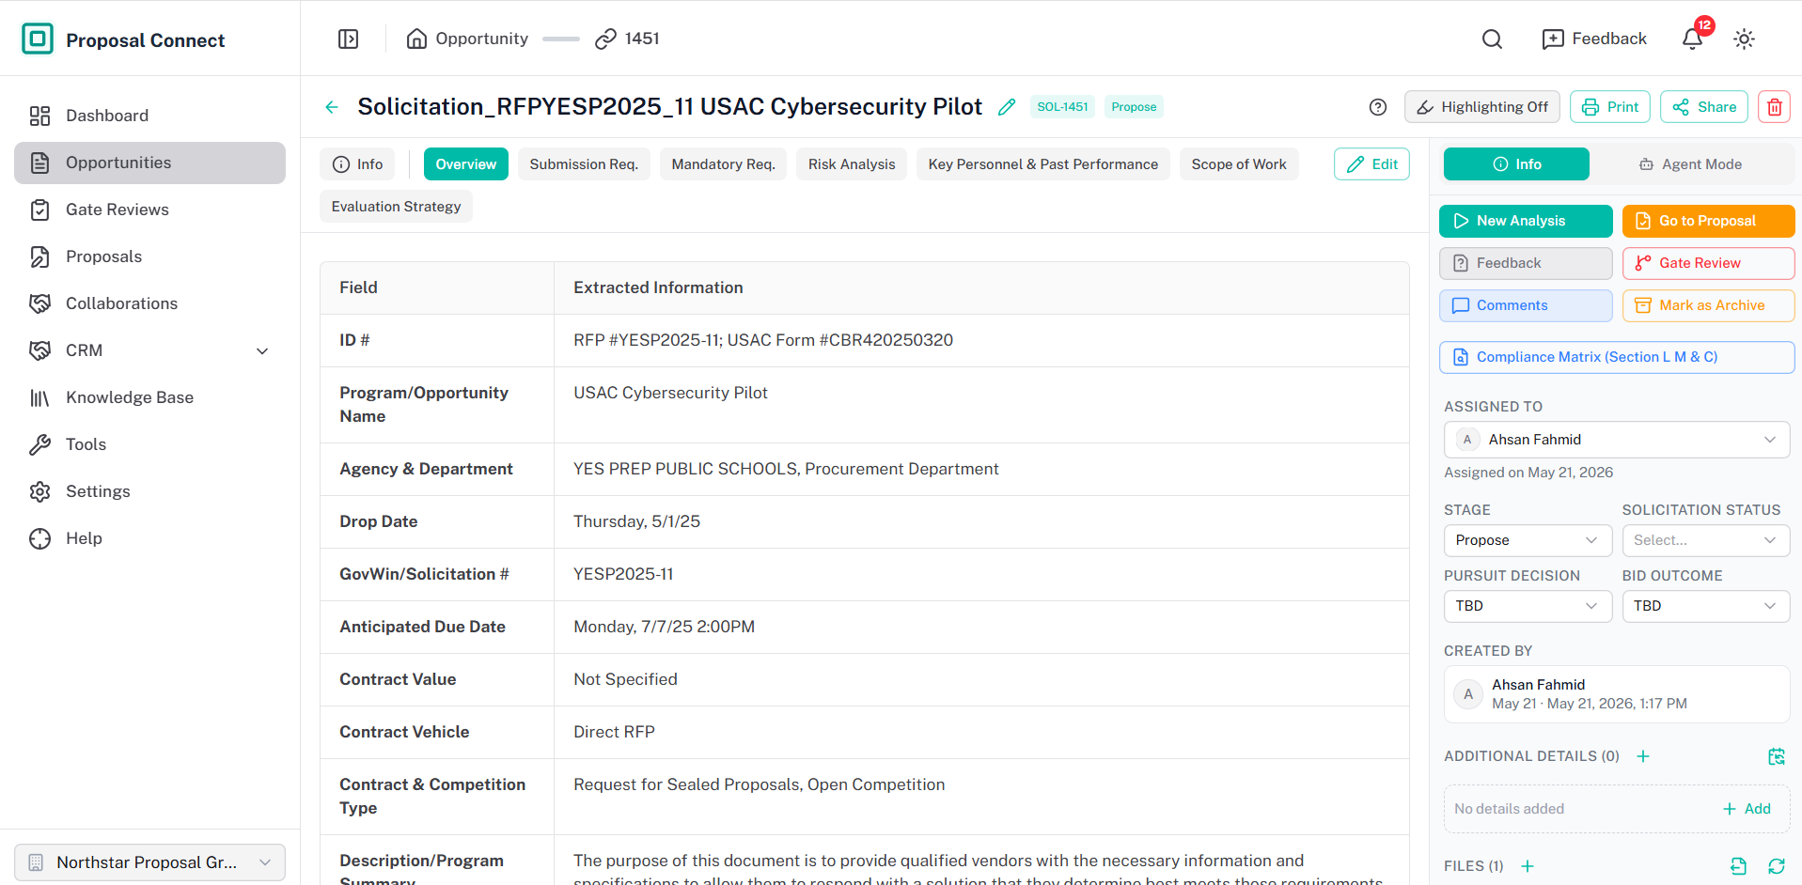
HOW IT WORKS
05 / 15
From solicitation to submission.
DISCOVER
app.proposalconnect.io/opportunities/SOL-1451
01
Source
Opportunity sourcing from GovWin IQ & SAM.gov.
02
Analyze
AI requirement extraction, section by section.
CAPTURE
03
GO / NO-GO
Structured scoring and disciplined gate reviews.
04
Draft
AI-generated, compliant proposal sections.
WIN
05
Track
A live compliance matrix for every “shall.”
06
Submit
Real-time collaboration, review, and export.
proposalconnect.io
Notes:
Six connected steps from discovery to submission, and a real look at extracted requirements.

Slide 6



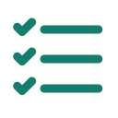

TRUST & SECURITY
06 / 15
Secure by architecture.
Data Isolation
Multi-tenant architecture keeps every account’s data fully separated.
Access Control
Role-based permissions per module and per team member.
Protect your pursuits.
Encrypted Storage
Documents and content secured at rest and in transit.
Audit Trail
Your data, your strategy, and your competitive edge — secured at every layer of the platform.
Every change, review, and decision tracked across the lifecycle.
Safe AI Processing
Your proprietary content is used only to serve your account.
proposalconnect.io
Notes:
Protect your pursuits, your data, and your competitive edge: data isolation, access control, encrypted storage, audit trail, and safe AI processing.

Slide 7
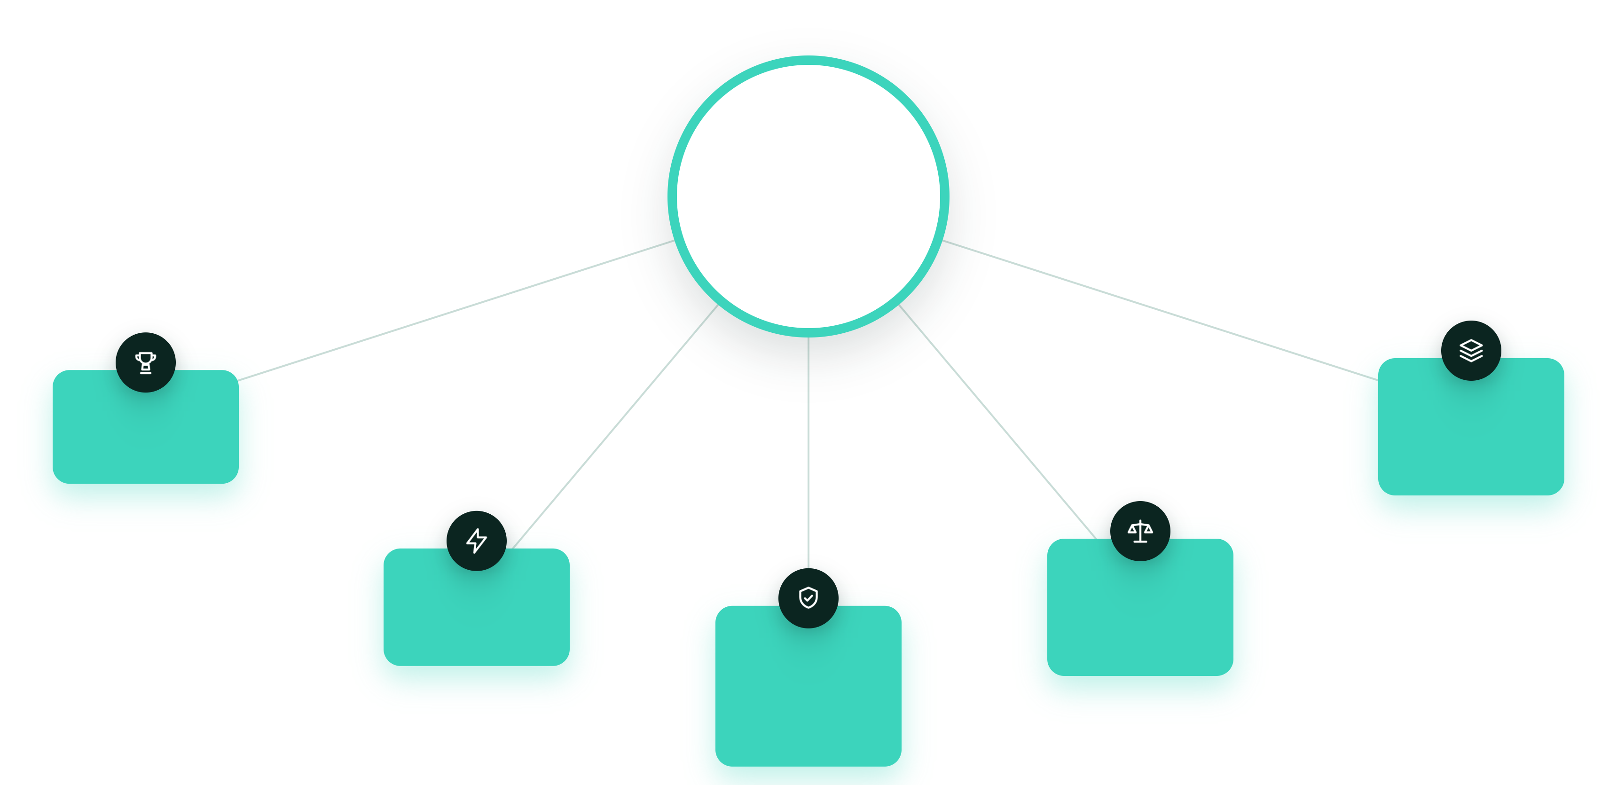
THE BENEFITS
07 / 15
Hours, not days. High win rates.
5
Key Benefits
of Proposal Connect
Win More Bids
Never miss a relevant opportunity
Reuse What Works
One central knowledge base
70% Faster Proposals
AI drafting & analysis
Smarter Bid Decisions
Disciplined
GO / NO-GO
Lower Compliance Risk
Automated requirement tracking
proposalconnect.io
Notes:
Five business benefits: win more bids, cut proposal time up to 70%, reduce compliance risk, bid smarter, and reuse what works.

Slide 8
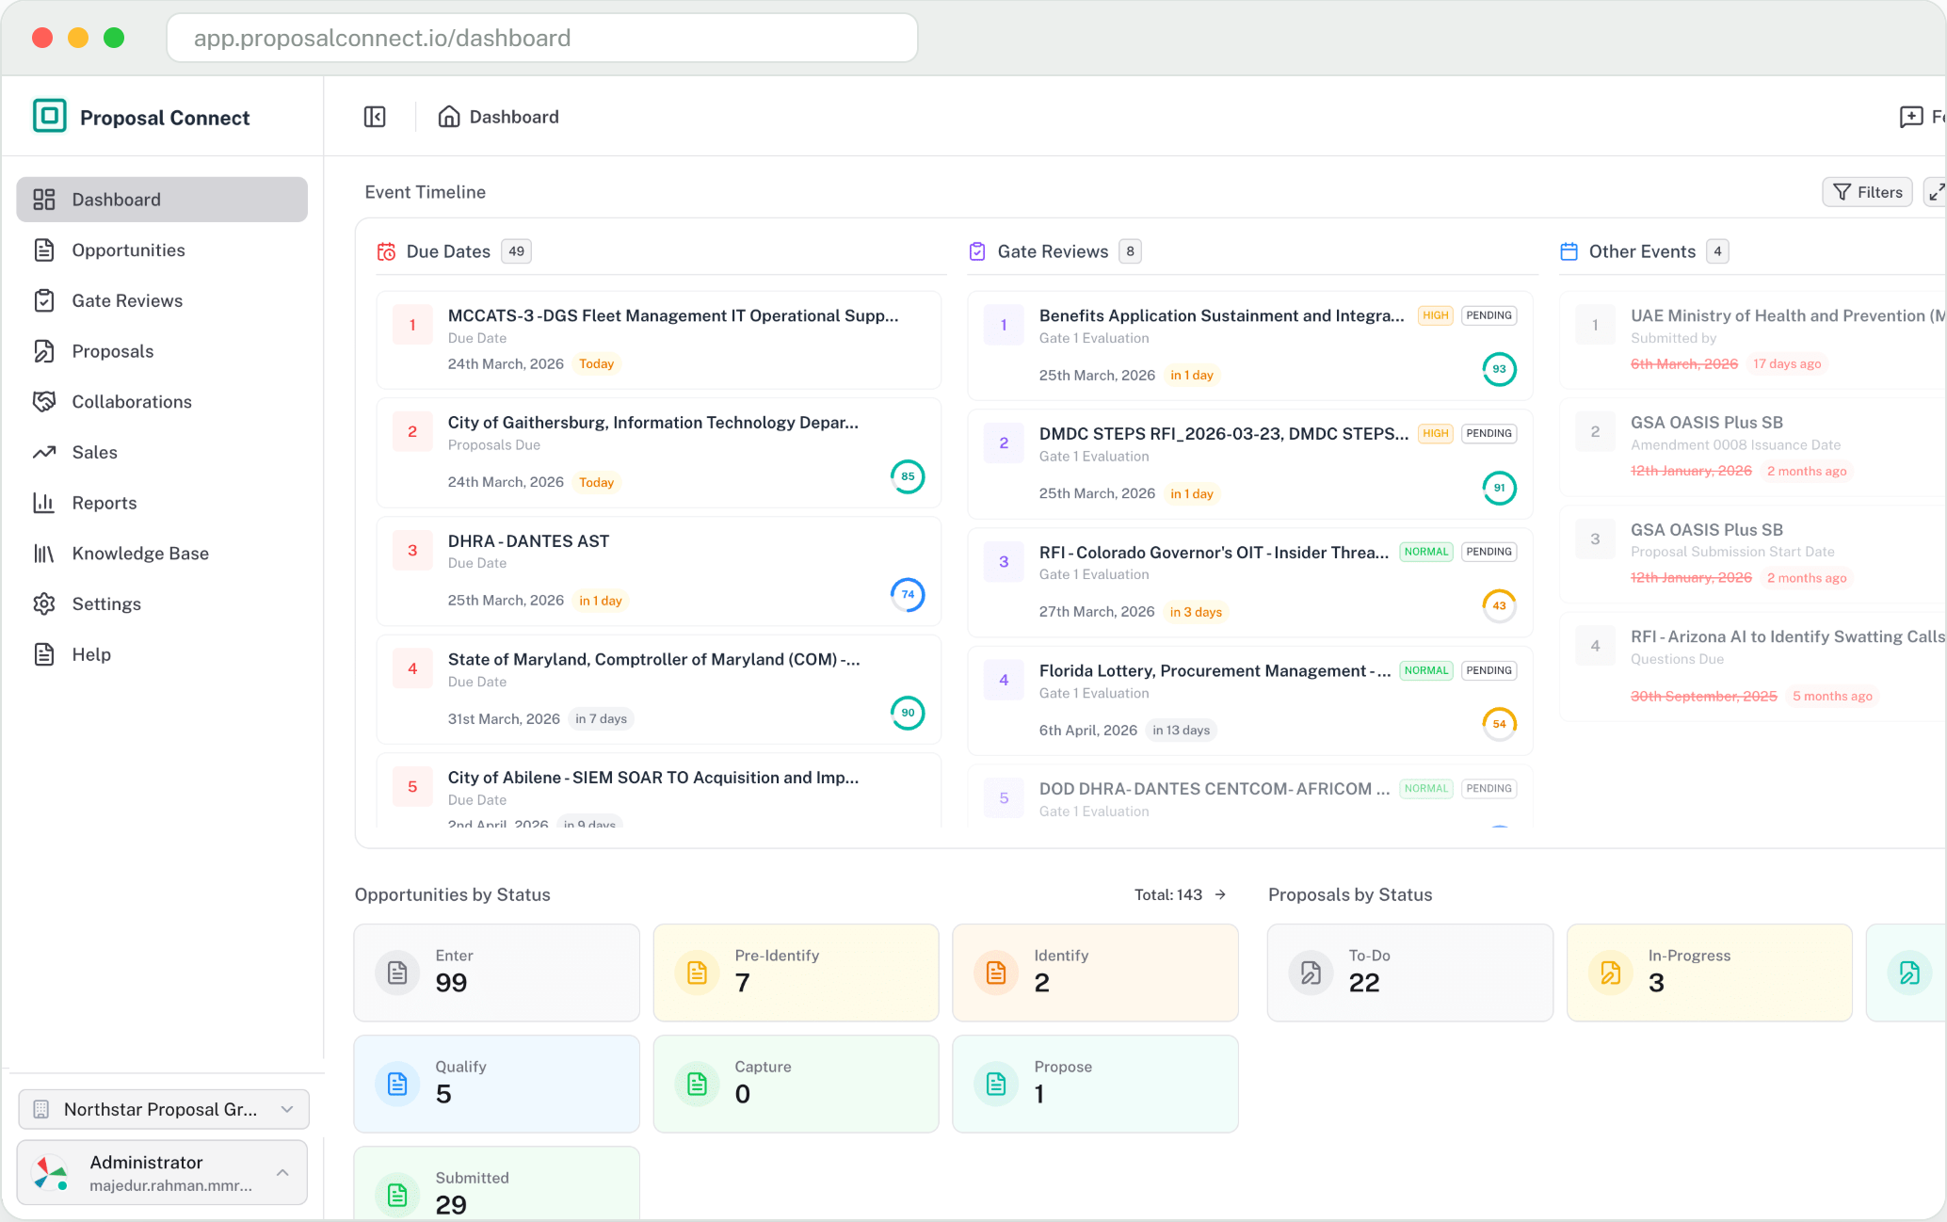

EFFICIENCY & ROI
08 / 15
Free your team to focus on winning.
Proposal Connect takes on the busywork — analysis, drafting, and compliance — so your people can do their best work.
70%
3 hrs
FASTER CYCLES
NOT 3 DAYS
AI drafting and analysis compress proposal time.
From a raw RFP to a structured analysis.
1
∞
TEAM, AMPLIFIED
PARALLEL PURSUITS
Handles the coordination so your team can focus on strategy.
Scales from a single bid to dozens.
proposalconnect.io
Notes:
Open with the brand promise: Proposal Connect is a next-gen, AI-powered GovCon platform. Discover, capture, win.

Slide 9
WHY SWITCH
09 / 15
Because the old way doesn’t scale.
TRADITIONAL PROCESS
PROPOSAL CONNECT
✕
Manual opportunity search
✓
Automated opportunity sourcing
✕
Weeks of RFP reading
✓
Instant AI RFP analysis
VS
✕
Spreadsheet compliance tracking
✓
Built-in compliance matrix
✕
Gut-feel bid decisions
✓
Data-driven GO / NO-GO scoring
✕
Copy-paste from old proposals
✓
AI drafting from your knowledge base
THE RESULT
From weeks to hours — up to 70% less proposal time, with higher win rates.
proposalconnect.io
Notes:
The competitive advantage: an AI-native, end-to-end GovCon platform versus a manual, spreadsheet-and-gut-feel traditional process.

Slide 10
PRICING
10 / 15
Designed for teams of every size
Save 10% with annual billing
MOST POPULAR
STARTER
PROFESSIONAL
ENTERPRISE
$499/mo
$2,499/mo
$3,999/mo
or $449/mo (billed yearly)
or $2,249/mo (billed yearly)
or $3,582/mo (billed yearly)
Small teams
Growing proposal teams
Medium–large orgs
✓
10 solicitations
✓
50 solicitations
✓
200 solicitations
✓
2 proposals
✓
5 proposals
✓
10 proposals
✓
1 team member
✓
5 team members
✓
Unlimited team members
✓
10 gate reviews
✓
30 gate reviews
✓
300 gate reviews
✓
30 analysis
✓
20 compliance
✓
100 compliance
✓
100 analysis
✓
300 analysis
✓
AI Document Analysis
✓
CRM
✓
AI Chat Assistant
✓
AI Document Analysis
✓
Multi-Account (Sub-Accounts)
✓
AI Content Generation
✓
AI Chat Assistant
✓
CRM
✓
SAM.gov Integration
✓
AI Content Generation
✓
AI Document Analysis
✕
compliance
✓
Proposal Collaboration
✓
AI Chat Assistant
✕
CRM
✓
GovWin Integration
✓
AI Content Generation
✕
Proposal Collaboration
✓
SAM.gov Integration
✓
Proposal Collaboration
✕
GovWin Integration
✕
API Access
✓
GovWin Integration
✕
API Access
✓
SAM.gov Integration
✓
API Access
Start 14-Day Free Trial
Start 14-Day Free Trial
Start 14-Day Free Trial
proposalconnect.io
Notes:
Simple, transparent pricing across three plans: Starter, Professional (most popular) and Enterprise, each with a 14-day free trial. Save 10% with annual billing; the yearly price is shown per month under each plan.

Slide 11
DISCUSSION
11 / 15
Questions?
Let’s transform how your team wins government contracts with Proposal Connect.
proposalconnect.io
Notes:
Open the floor for questions. Reiterate the mission: transform how teams win government contracts.

Slide 12
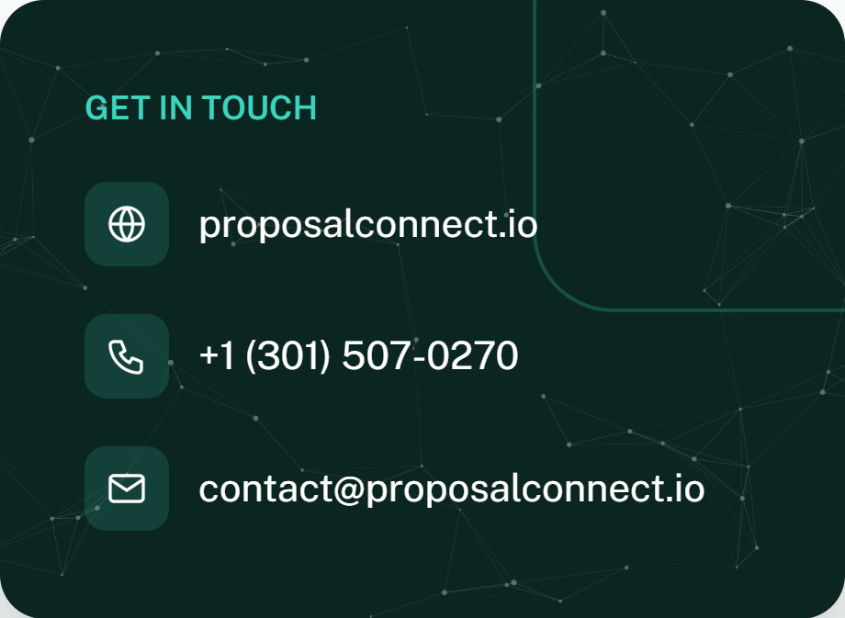
GET STARTED
12 / 15
FROM 3 DAYS TO 3 HOURS
See how Proposal Connect speeds up your cycle.
Get Started Free →
Book a Demo
proposalconnect.io
Notes:
The ask: get started free at proposalconnect.io. From 3 days to 3 hours — see the proposal cycle speed up. Provide phone and email.

Slide 13
ABOUT
13 / 15
Proposal Connect Team.
PC
Proposal Connect — purpose-built for government contracting.
OUR VALUE PROPOSITION
Proposal Connect unifies opportunity discovery, capture management, compliance analysis, AI-assisted proposal generation, and workflow automation — helping contractors identify opportunities sooner, collaborate better, and submit higher-quality proposals with less manual effort.
AI
AI-Powered for GovCon — discover, capture, analyze, comply, win.
Discover, capture, win.
McLean, VA — 7925 Jones Branch Dr, Suite LL120.
Connect
LinkedIn
Facebook
YouTube
proposalconnect.io
Notes:
Proposal Connect: a next-gen, AI-powered GovCon platform headquartered in McLean, VA. Focused on compliance, capture, and win-rate improvement.

Slide 14
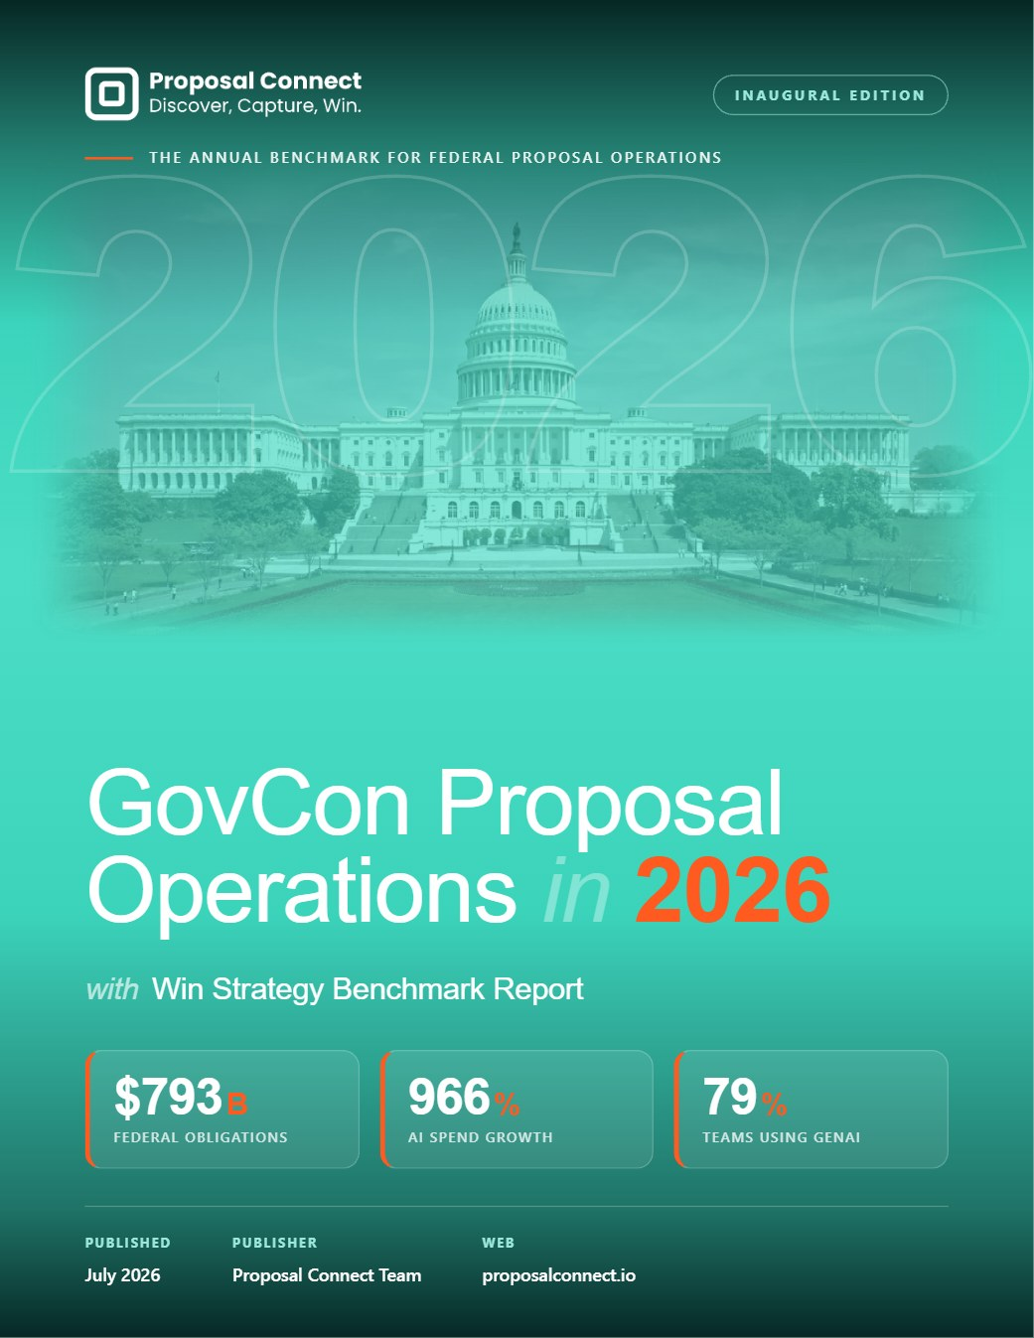
INDUSTRY REPORT
14 / 15
Annual GovCon Industry Report 2026.
Our inaugural proposal-operations & win-strategy benchmark — nine findings that define the year.
$793B
+966%
79%
Federal obligations, FY2025 — a record.
Federal AI funding growth, FY24 → FY26.
Of teams now use generative AI.
01
Spending is bigger but more concentrated.
Awardees fell from 108,899 to 105,044 — a 3.5% decline favoring incumbents.
02
Bandwidth has overtaken every other pain.
Team capacity is now the #1 challenge for RFP teams — a benchmark first.
03
Top performers are pulling away.
Top-quartile teams win 60%+ vs ~40% for public-sector contractors.
Download the free report →
proposalconnect.io
Notes:
Open with the brand promise: Proposal Connect is a next-gen, AI-powered GovCon platform. Discover, capture, win.

Slide 15



15 / 15
Thank you.
proposalconnect.io
+1 (301) 507-0270
contact@proposalconnect.io
7925 Jones Branch Dr, Suite LL120, McLean, VA 22102
Discover, capture, win.
Notes:
Close with thanks and full contact details. Reinforce the slogan: Discover, capture, win.

